Slide 1
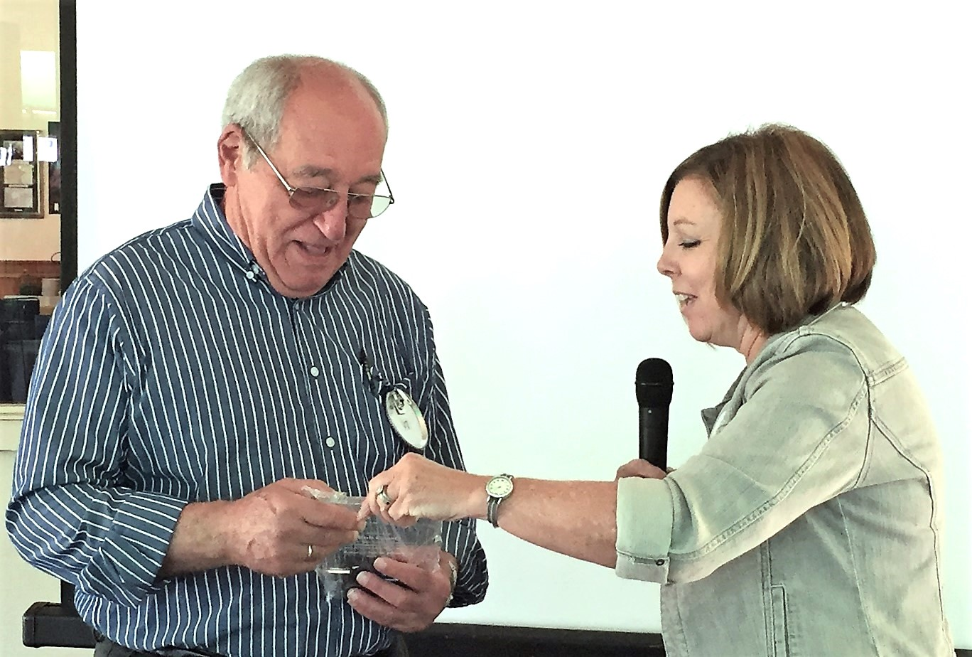
Bob Cassis – A Lifetime of Service
Milk delivery starting at age 11
U.S. Coast Guard Captain – Retired 2000
Lacey Rotary Club 1992-2000
Youth for Christ
Various ministries as Pastor
Silverdale Rotary Club – 2000-2002
Silverdale Sunrise RC – 2002-2011
Silverdale Rotary Club – 2011-2024
SRC Honorary Member – June 2024
Rotarian of the Year
2016-2017

Slide 2
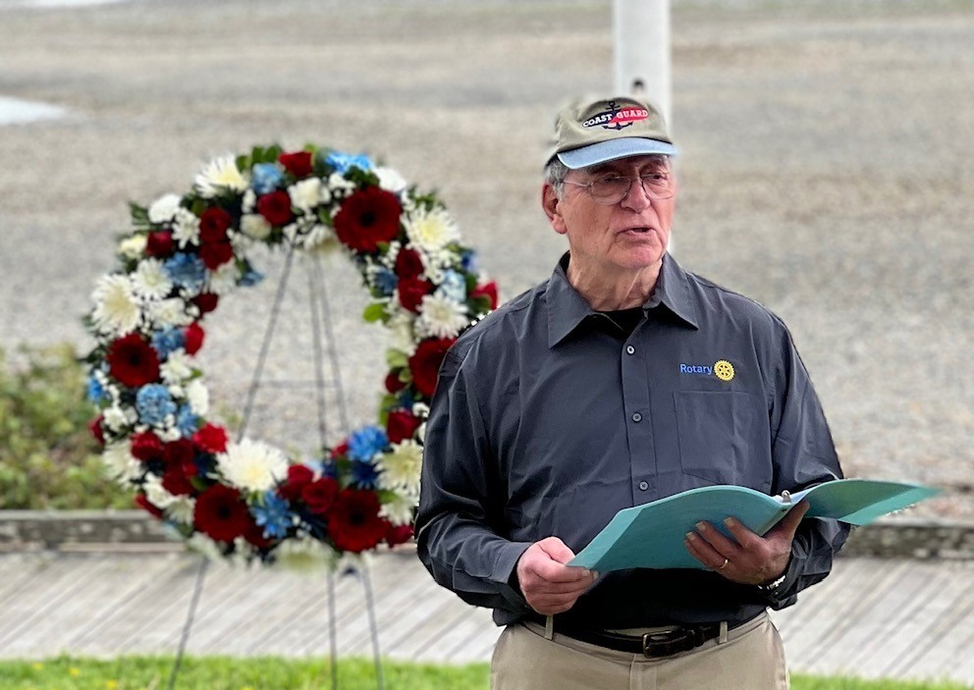
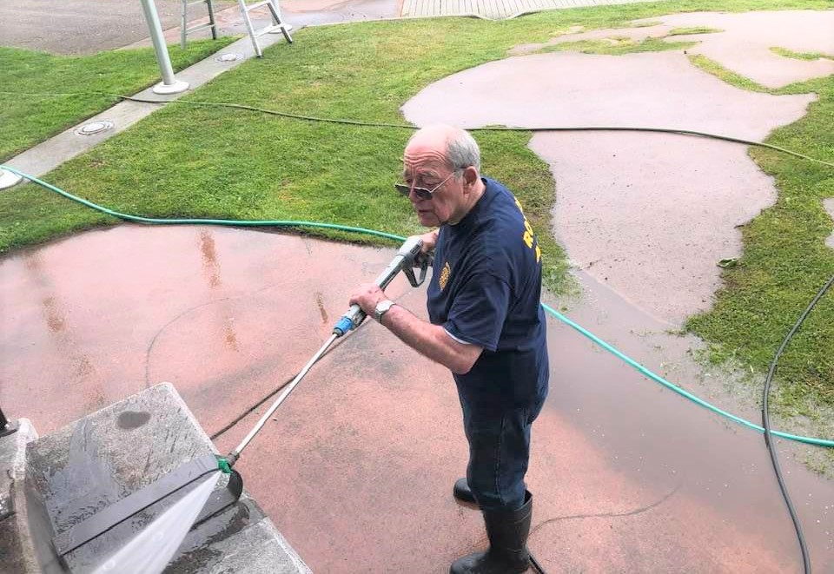
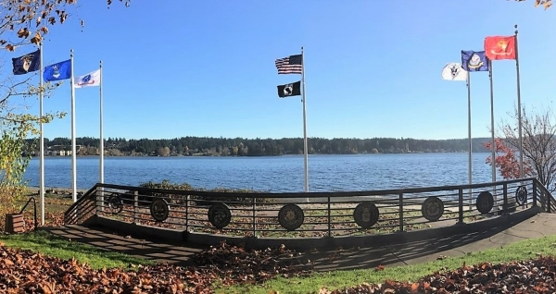
Silverdale Veteran’s Memorial Park
- Built with Silverdale Sunrise Rotary Club
- Maintenance of Flags & Poles
- Memorial Day Observances

Slide 3
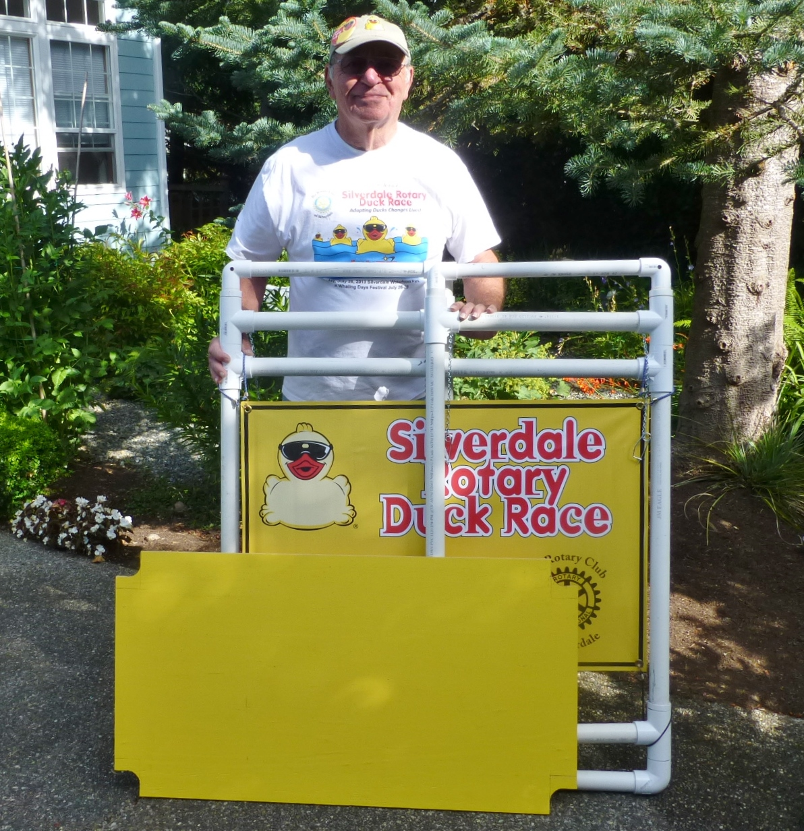
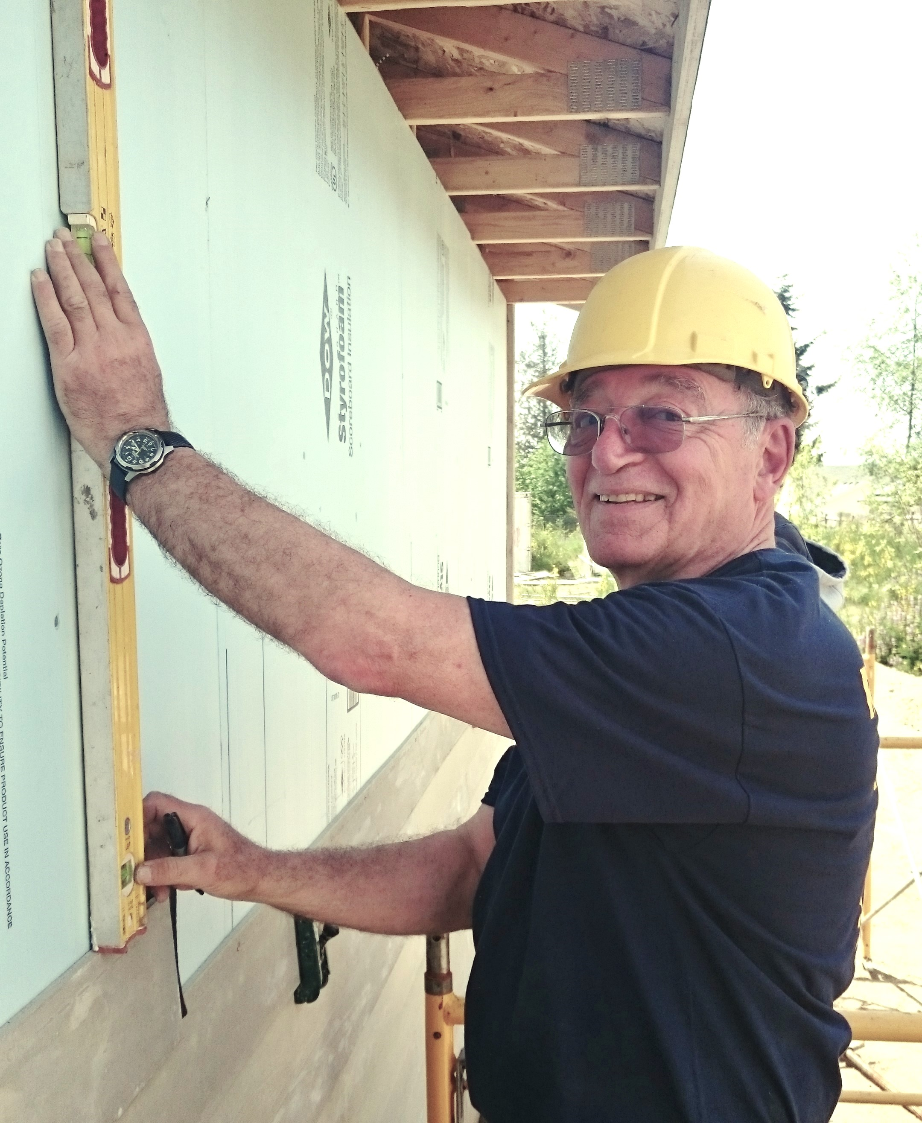
Engineer & Builder
Duck Selling Booths
Designed & Built
Delivered to Venues
Habitat for Humanity

Slide 4
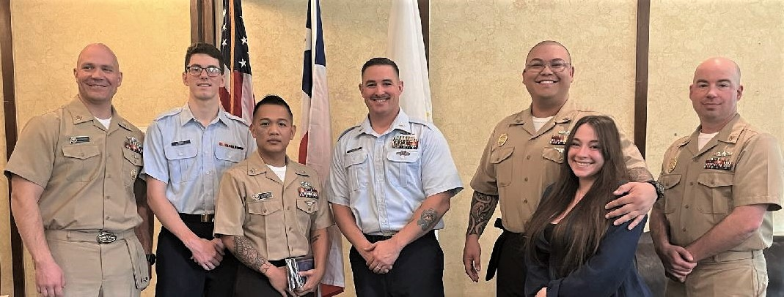
Coast Guardsman of the Quarter
Connected with local Coast Guard
Initiated Coast Guardsman of the Quarter with SRC
Added to Sailors and Marines of the Quarter

Slide 5
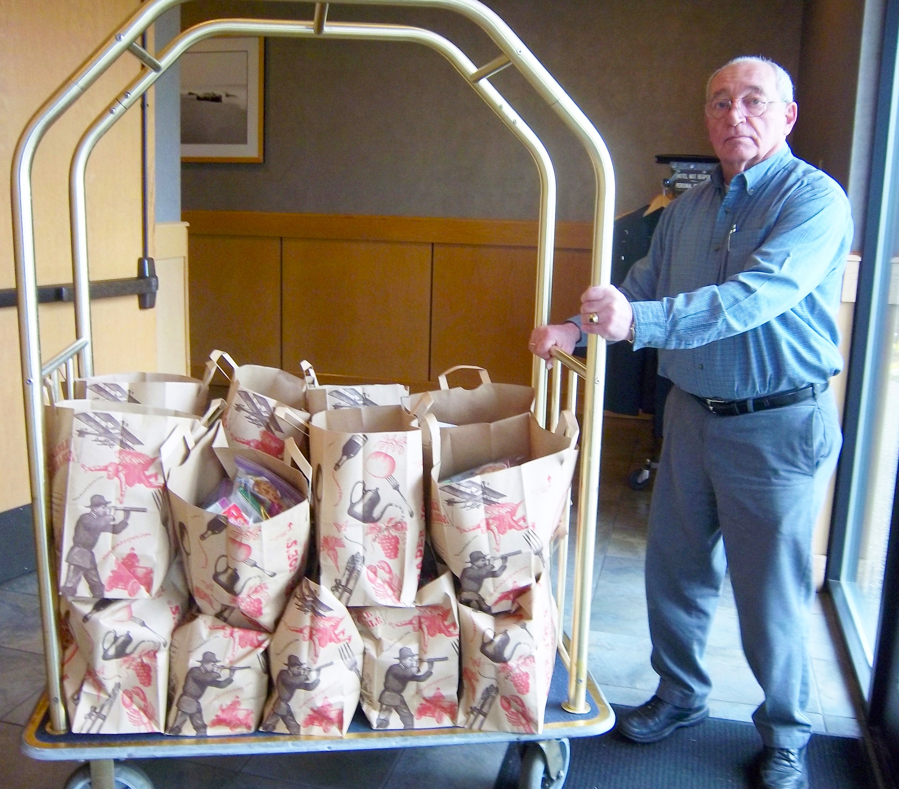
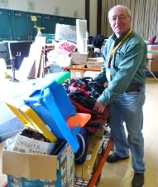
Community Service
RAGS
Food Bagging

Slide 6
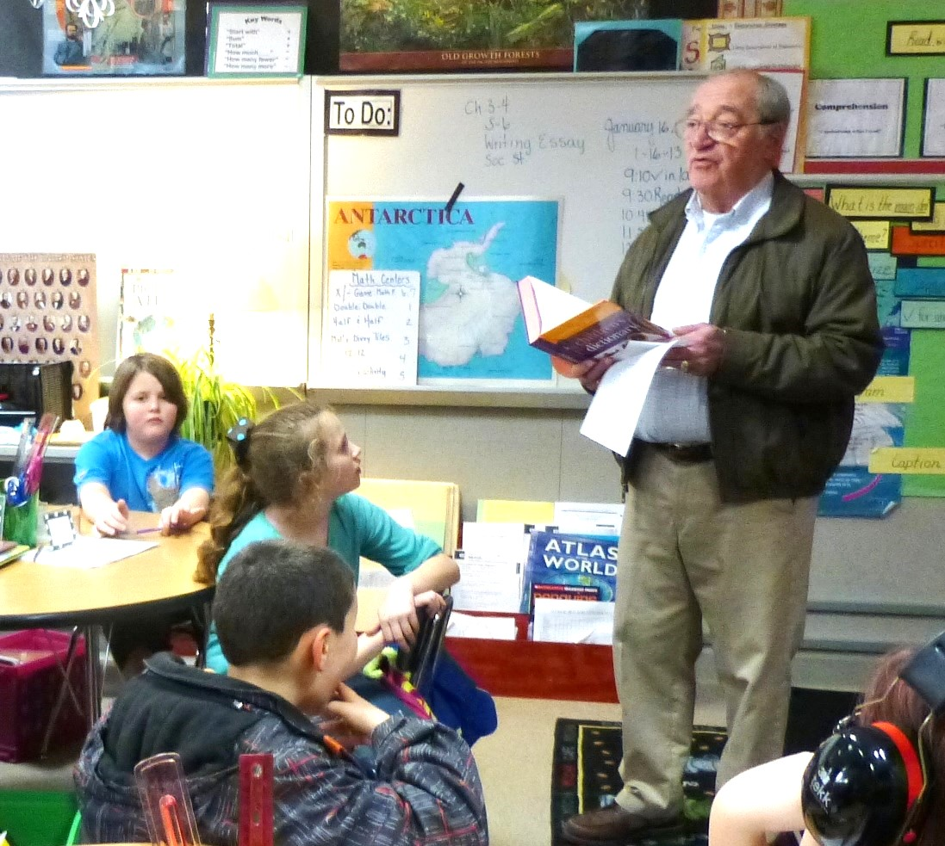
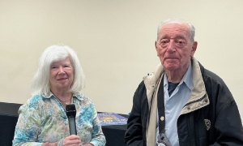
3rd Grade Dictionaries
The Rotary Foundation
EREY for decades
Paul Harris Fellow +4

Slide 7

THANK YOU, BOB for EVERYTHING!

